Slide 1
Introduction to Unsupervised Learning
Definition: Unsupervised learning is a type of machine learning where the algorithm learns patterns from input data without labeled responses or explicit feedback. Unlike supervised learning, where the algorithm learns from labeled examples, unsupervised learning algorithms explore the data and draw inferences or discover structures on their own.
Goal: The primary goal of unsupervised learning is to uncover hidden patterns or structures within data without the need for labeled responses or explicit guidance. Unlike supervised learning, where algorithms are trained on labeled examples to make predictions or classifications, unsupervised learning algorithms explore data autonomously.

Slide 2
Key Concepts in Unsupervised Learning
Unlabeled Data: Data without predefined categories or labels.
Clustering: Grouping similar instances together based on their features. Clustering algorithms include k-means, DBSCAN (Density-Based Spatial Clustering of Applications with Noise), and hierarchical clustering.
Dimensionality Reduction: Reducing the number of random variables under consideration to obtain a set of principal variables. Techniques like Principal Component Analysis (PCA), t-SNE (t-Distributed Stochastic Neighbor Embedding), and Autoencoders are used for dimensionality reduction.

Slide 3
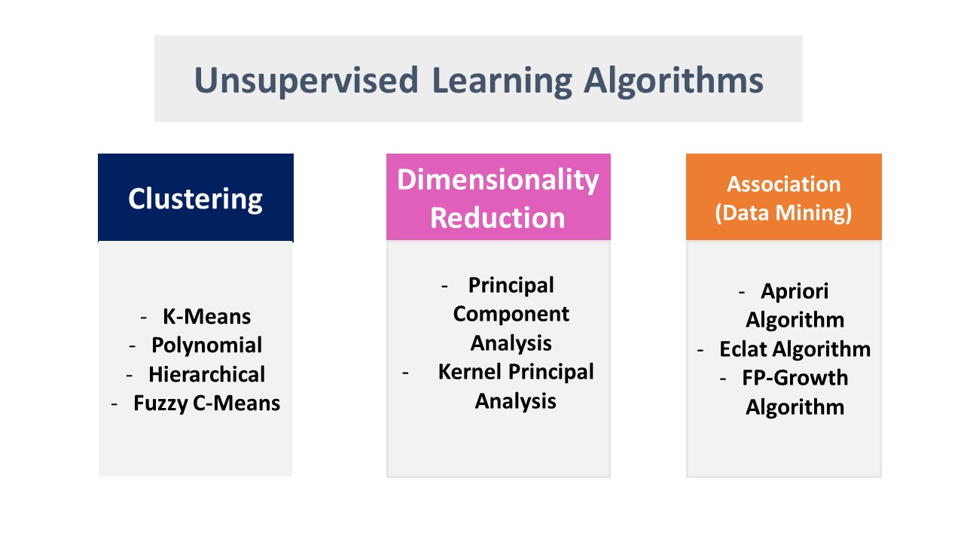
Types of Unsupervised Learning Algorithms
Clustering Algorithms: Algorithms that group similar data points (e.g., k-means, hierarchical clustering).
Association Algorithms: Algorithms that find rules that describe large portions of data (e.g., Apriori, Eclat).
Dimensionality Reduction Algorithms: Algorithms that reduce the number of random variables (e.g., PCA, t-SNE).

Slide 4
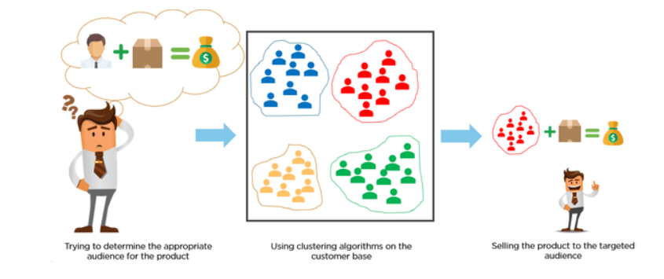
Clustering
Definition: Clustering is the task of dividing the population or data points into a number of groups such that data points in the same groups are more similar to other data points in the same group than those in other groups.
Popular Algorithms: k-means, hierarchical clustering, DBSCAN.

Slide 5
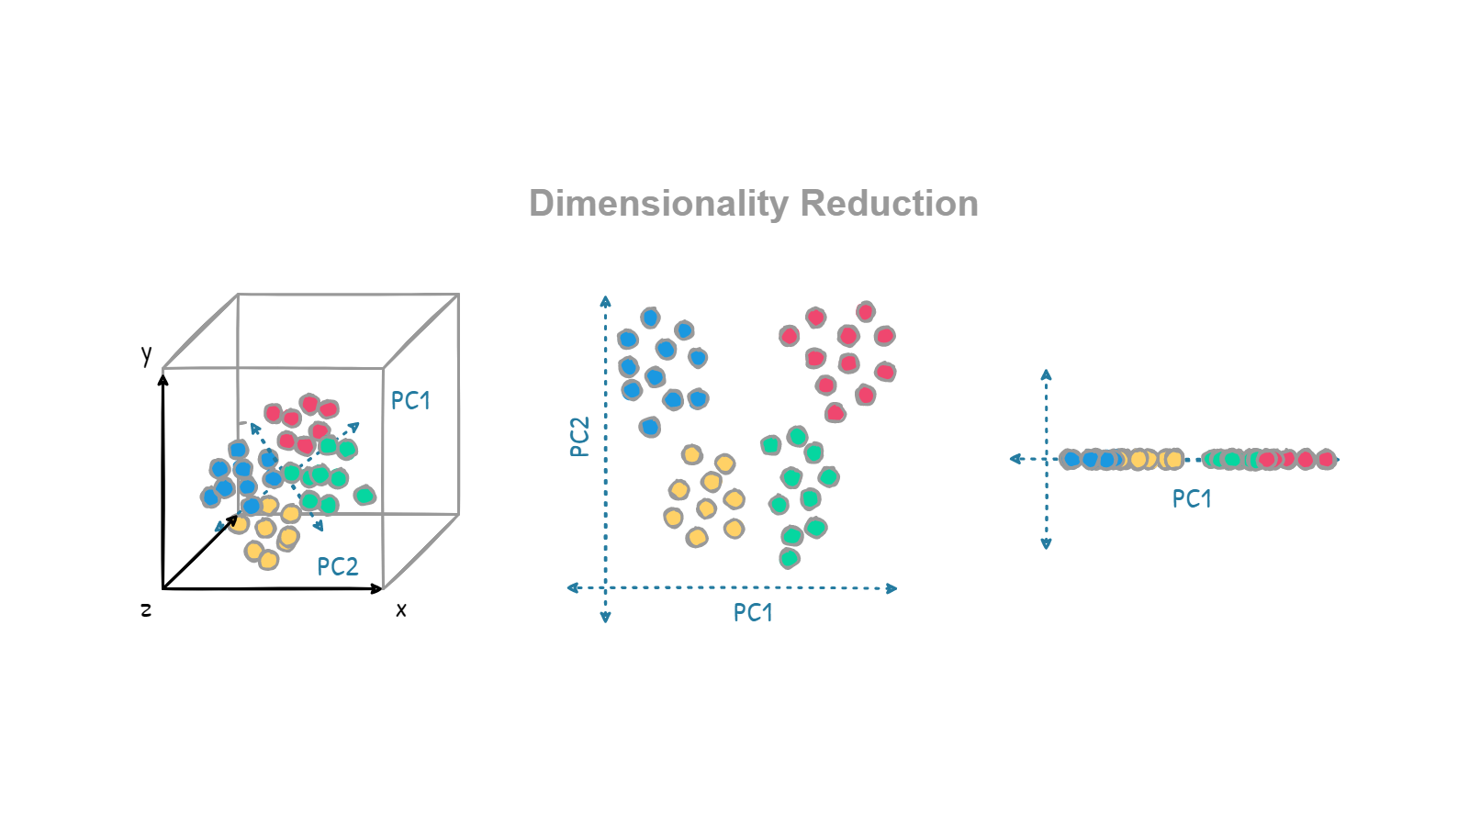
Dimensionality Reduction
Definition: Dimensionality reduction refers to the process of reducing the number of random variables under consideration, often with the goal of capturing as much relevant information as possible in a dataset. This process is crucial in data preprocessing and analysis
Popular Techniques: Principal Component Analysis (PCA), t-Distributed Stochastic Neighbor Embedding (t-SNE).

Slide 6

Anomaly Detection
Definition: Anomaly detection, also known as outlier detection, is a technique used in data mining and machine learning to identify observations or instances that deviate significantly from the majority of the data. These anomalies can represent critical events, errors, or unusual patterns that require special attention due to their potential significance or peculiarity.
Application: Used in fraud detection, network security, and fault detection.

Slide 7
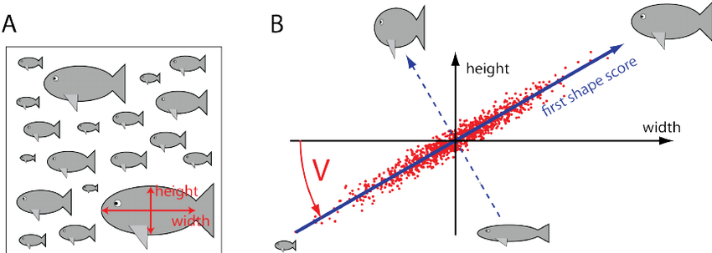
Principal Component Analysis (PCA)
Definition: PCA, or Principal Component Analysis, is a widely used technique in data analysis and machine learning for dimensionality reduction. It's primarily used to simplify datasets by reducing the number of variables (or dimensions) while retaining as much variance as possible.
Application: Used to simplify data, reduce noise, and highlight differences.

Slide 8
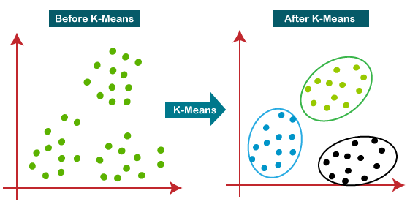
k-Means Clustering
Definition: k-Means clustering is a method of vector quantization that aims to partition n observations into k clusters in which each observation belongs to the cluster with the nearest mean.
Application: Used for market segmentation, document clustering, and image compression.

Slide 9
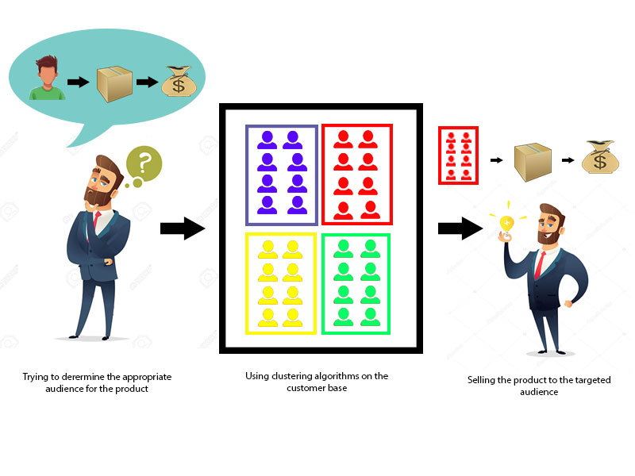
Example: Customer Segmentation
Dataset: Description of features like purchase history, demographics, etc.
Algorithm: k-Means clustering used to segment customers.
Outcome: The model identifies distinct customer groups for targeted marketing.

